Slide 1

: Sprint 1 – Field Execution & Monitoring MVP

Slide 2
Sprint 01: Field Execution & Monitoring MVP
Digital Bridge Between Field Operations and Business Units
Module: Commercial Computing
Group: 06
Technology Stack: Flutter | ASP.NET Core | PostgreSQL | React

Slide 3








Sprint 1 Vision
Vision
To digitize the daily workflow of a Sales Representative and make field data visible to Business Units in real time.
Mission
Deliver a complete operational flow:
Start Day
Visit Shops
Collect Data
Order
Delivery
Returns
Upload
Monitor in Web

Slide 4
Core Features Covered
Core Feature 02 – Collecting Data
Core Feature 03 – Monitoring (Basic)
Shelf & stock checks (OSA)
Smart order suggestion
Delivery handling (Full / Partial)
Lorry stock reconciliation
Returns management
Role-based BU dashboard
View visits, OSA issues, orders, deliveries, returns
(Route optimization intentionally deferred to Sprint 2)

Slide 5
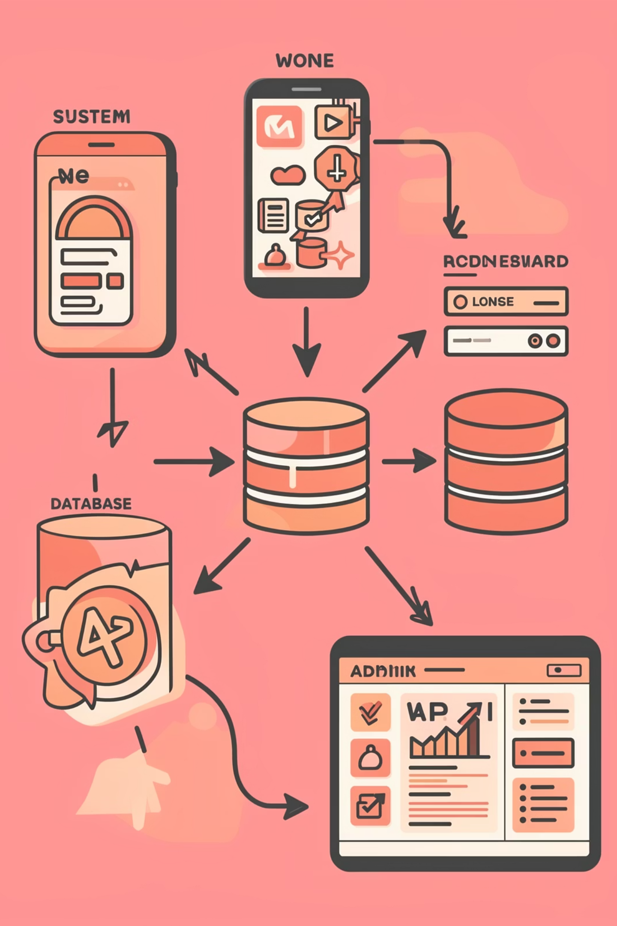
System Architecture
Architecture Overview
Flutter Mobile (Offline) ↓ ASP.NET Core Web API ↓ PostgreSQL Database ↑ React + Tailwind Admin Dashboard
Key Principle
Single backend
Single central database
Role-based access
Offline-first mobile design

Slide 6
Technology Stack & Justification
Mobile
Backend
Flutter → Cross-platform → Fast UI development → Offline capability
ASP.NET Core Web API → Enterprise-grade → Strong validation & security → Clean architecture
Database
Admin Web
PostgreSQL → Relational integrity → Ideal for stock/order systems → Strong reporting capability
React + Tailwind → Modern UI → Component-based → Scalable

Slide 7
Daily Workflow (Sales Rep)
01
02
03
Login
View Due Shops (14-day visit rule)
Start Day (Vehicle + Opening Stock)
04
05
06
Visit Shop
Shelf & Backroom Check
Order Creation
07
08
09
Delivery (Full/Partial)
End Day Reconciliation
Upload Data

Slide 8
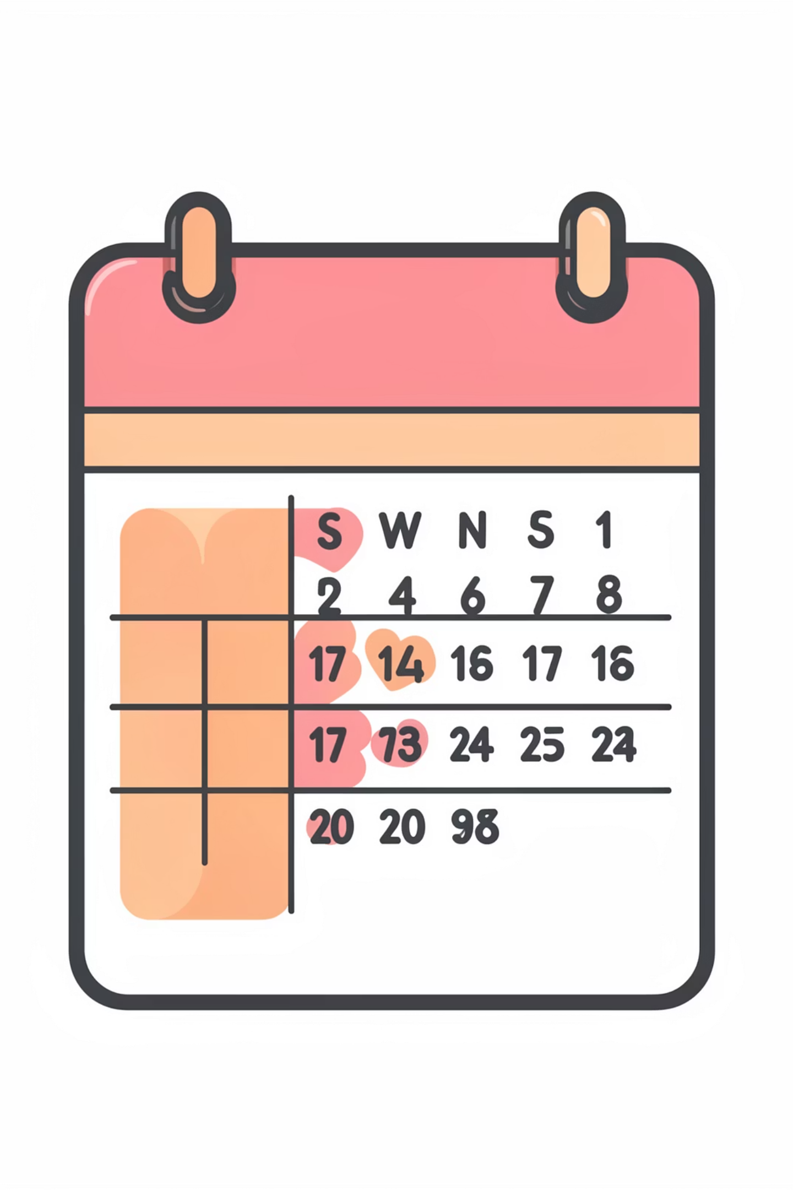
Visit Frequency Logic
Business Rule: Shop must be visited once every 14 days (configurable).
System Logic: If lastVisitedDate + frequencyDays ≤ today → Shop appears in “Due Today” list
Admin can modify frequency via dashboard.

Slide 9
Smart Order & Delivery Logic
Smart Order Suggestion
Delivery Handling
Suggested = Avg Sales × Lead Time − (Shelf + Backroom)
If lorry stock ≥ order qty: → Completed
If lorry stock < order qty: → Partial delivery → Backorder auto-created

Slide 10
Data Upload & Sync
Offline-first approach:
All data stored locally
Bulk sync at end of day
API: POST /sync/day
Benefits:
Handles poor connectivity
Reduces API calls
Cleaner audit trail
BU Monitoring Dashboard
BU can view:
Visits per Rep
OSA Issues
Orders summary
Delivery status
Returns
Filters:
Date range
Territory
Rep
Role-based login implemented.

